Slide 1

Project 4 Firewall and IDS Configuration
URVESH GANDHI

Slide 2
Summary
Install Snort on pfSense:
Installing Snort on the pfSense package manager & configure it.
Log Suspicious Activity:
To monitor log suspicious activity on both Untrusted and DMZ network interfaces set up snort
Configure Alerts for Exploits:
Configure Snort to detect and alert on specific exploits used in your previous project
lock FTP Traffic:
Create firewall rules to block FTP traffic from Untrusted network to DMZ interface .
Testing and Verification:
Using Wireshark test snort alerts and firewall rule effectiveness.

Slide 3
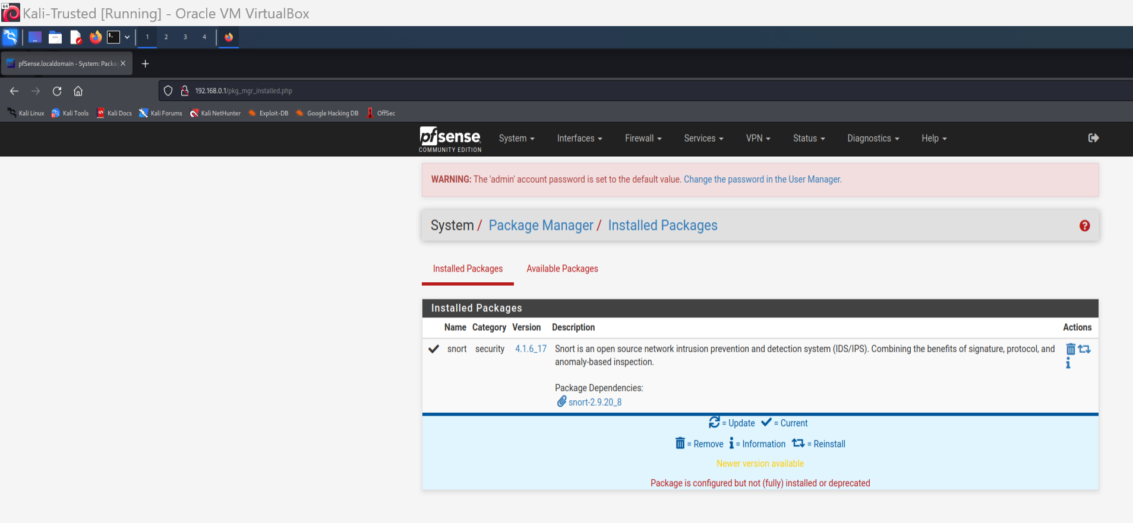
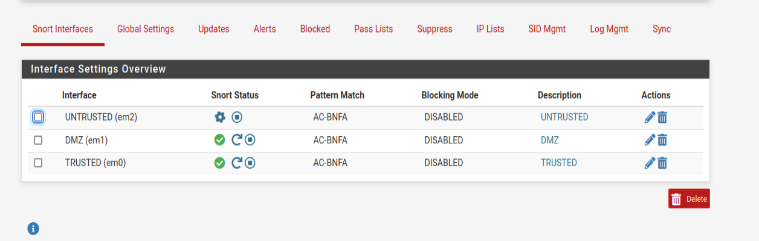
Download and install Snort on the pfSense firewall.

Slide 4
Use of Snort
Snort Installation and Setup
Monitoring and Logging Suspicious Activity
Alert Configuration for Exploits:
Blocking FTP Traffic
Testing and Verification

Slide 5
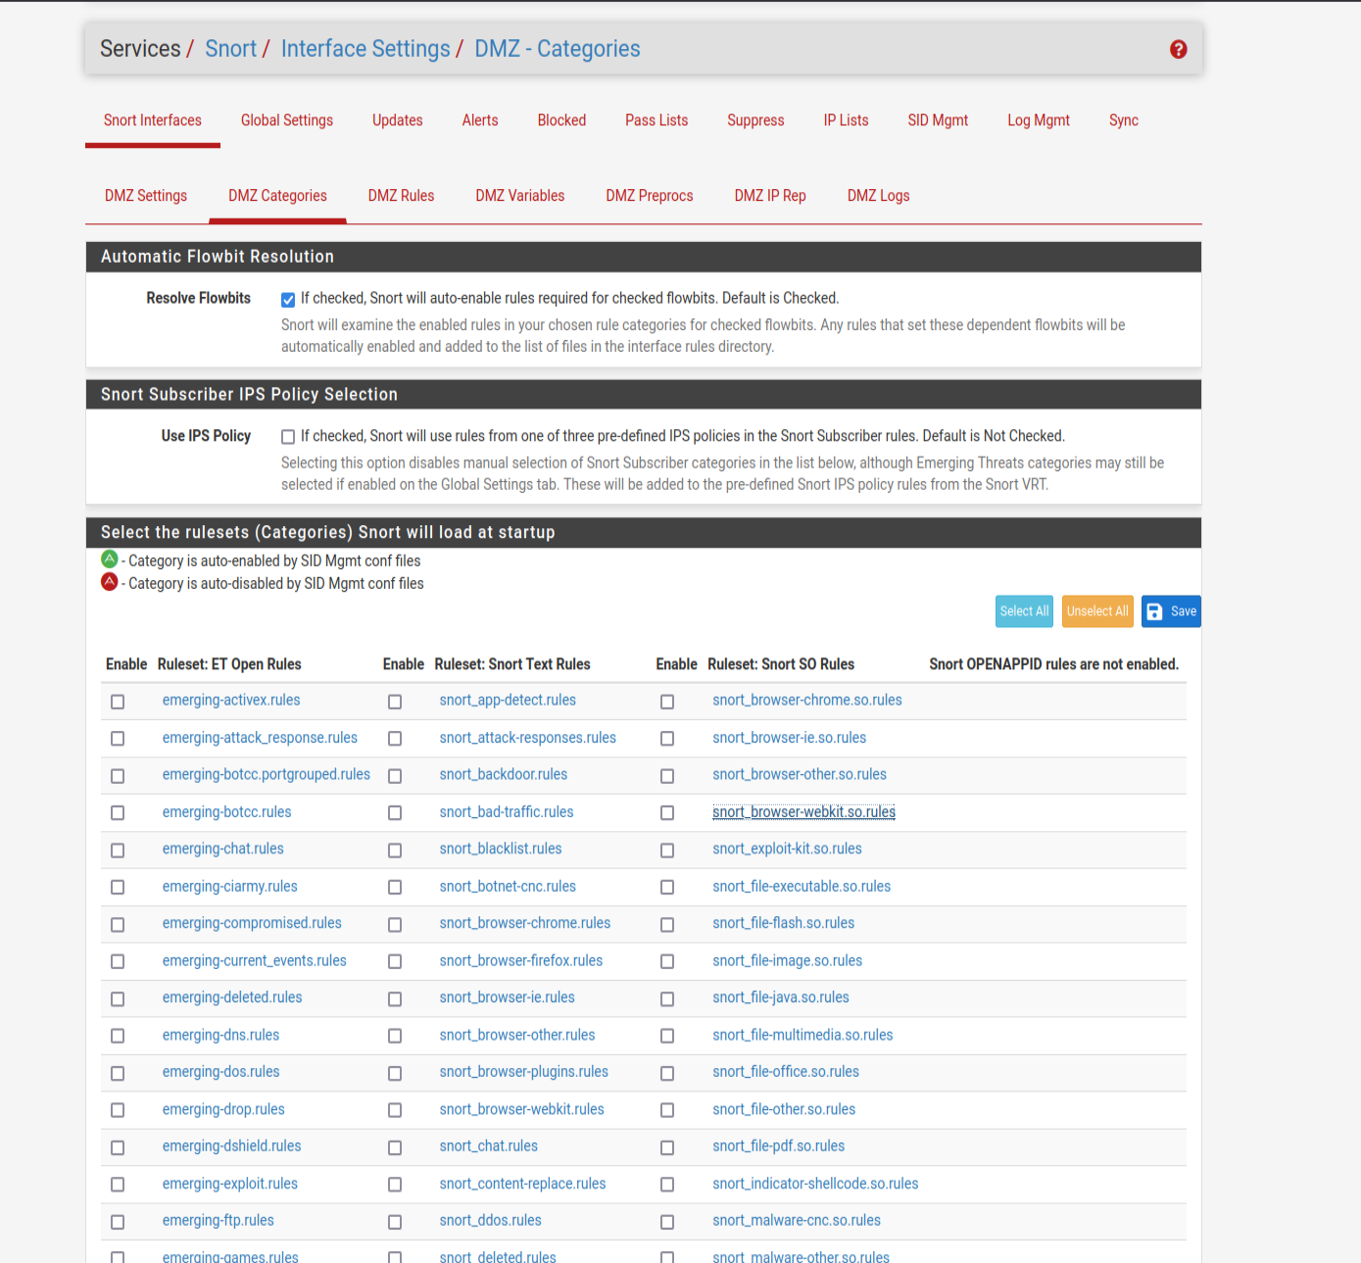
Snort interface settings

Slide 6
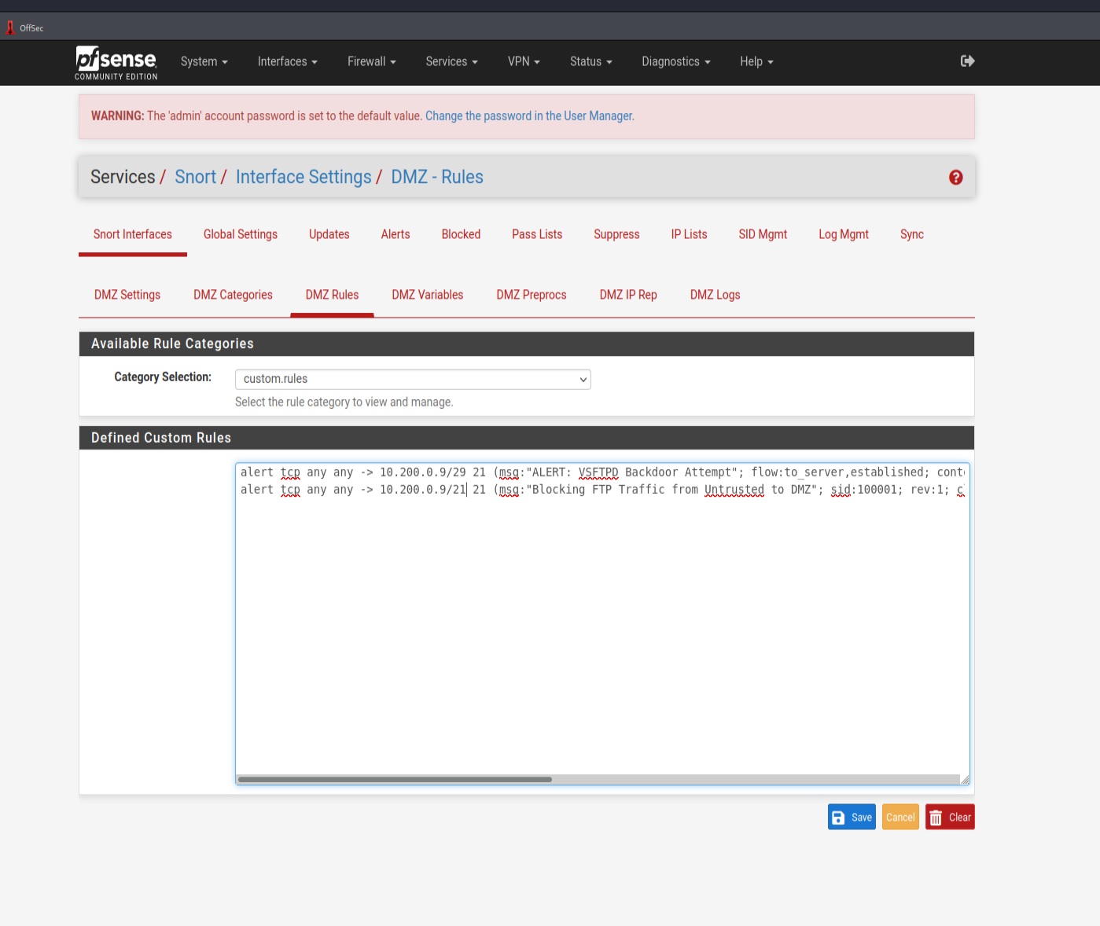
Snort custom rules

Slide 7
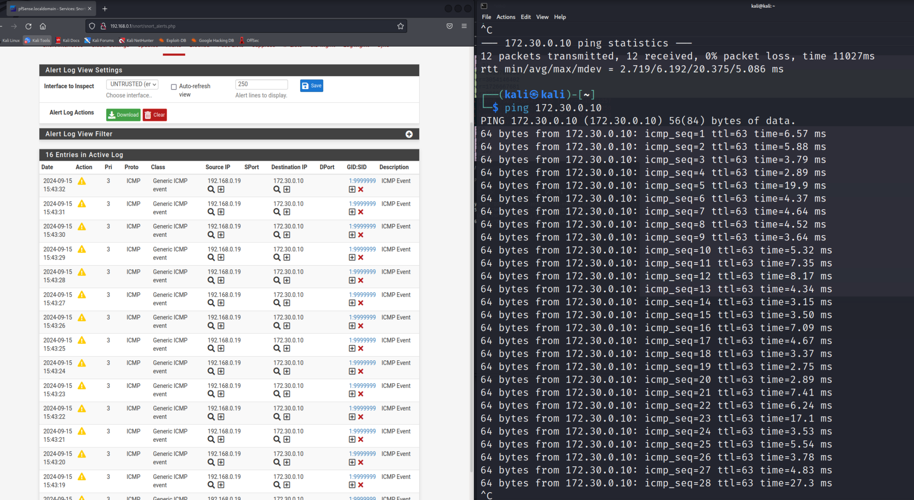
log suspicious activity on the Untrusted interface

Slide 8
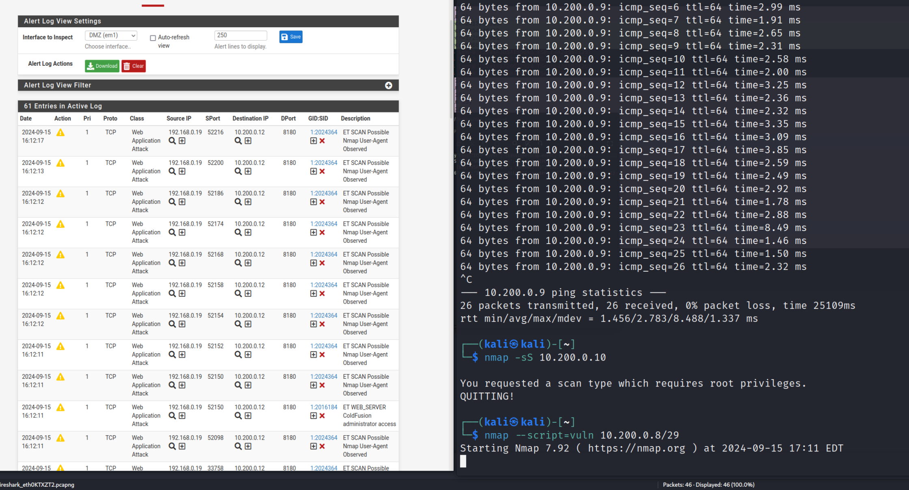
log suspicious activity on the DMZ interface

Slide 9
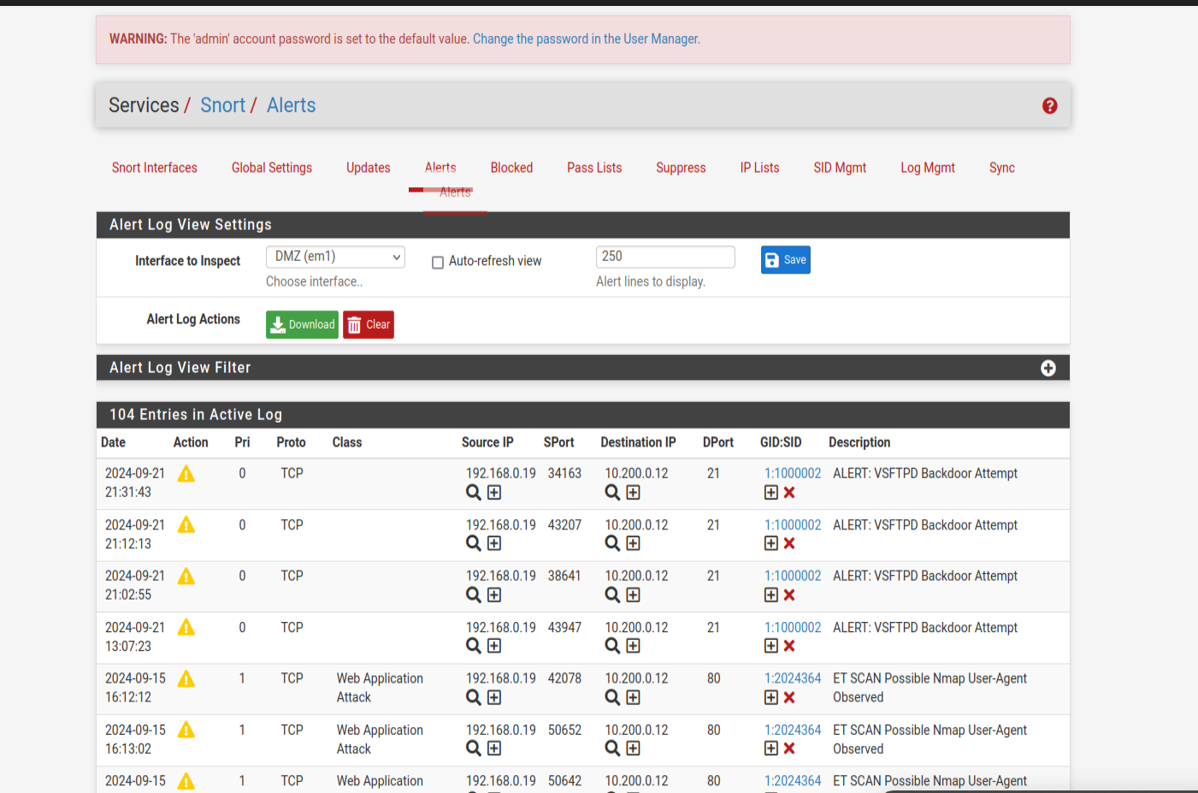
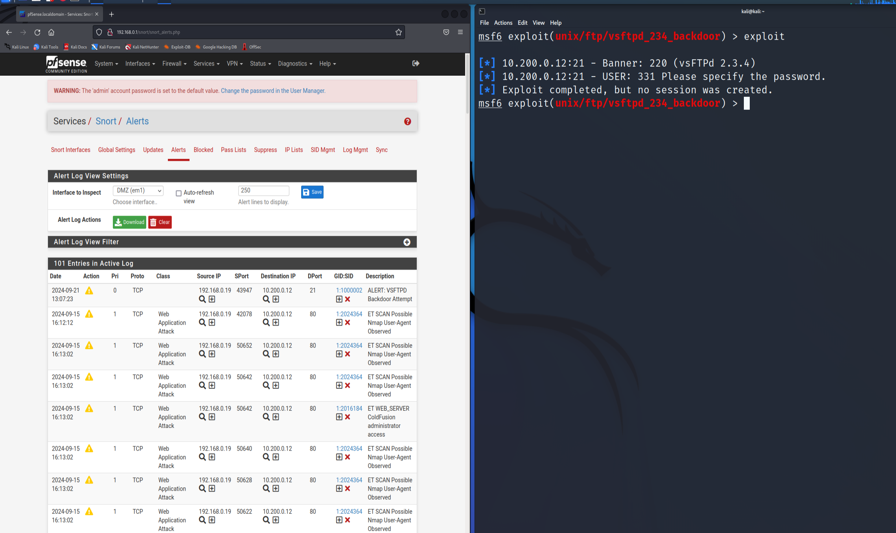
Snort to alert to Web Server port(21) exploit

Slide 10
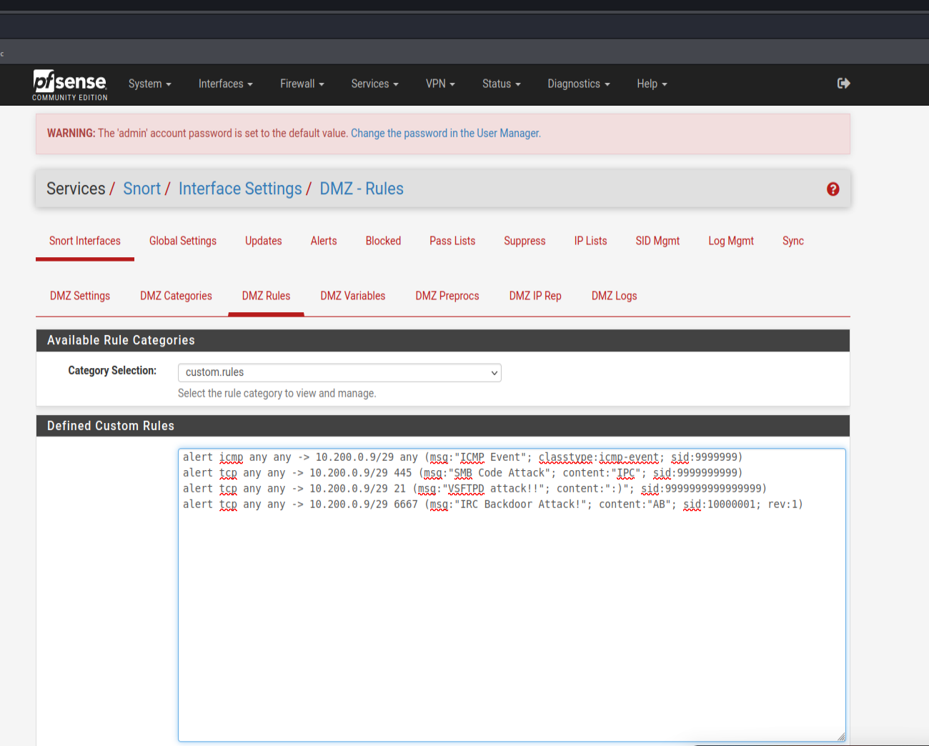
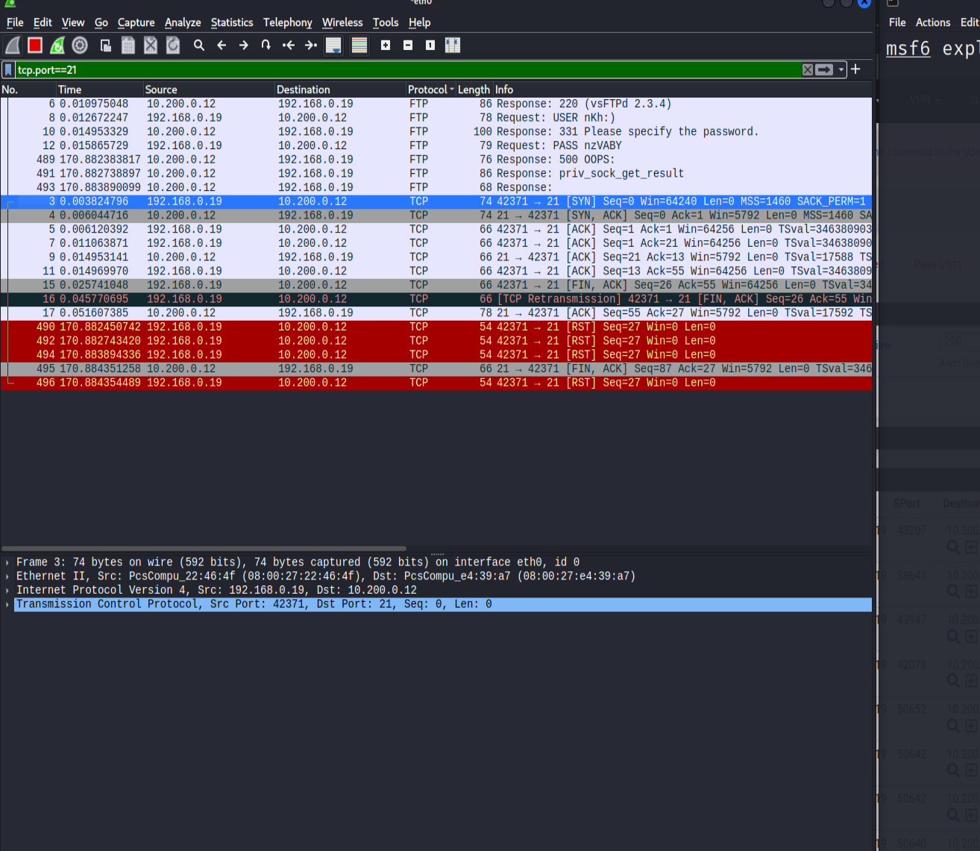
firewall rules to block FTP traffic

Slide 11
Recommendations to improve server security
Keep Systems and Software Updated
Enable and Configure a Firewall
Secure Remote Access
Implement Regular Security Audits and Monitoring
Implement Security Policies and Training
Regular Backups and Disaster Recovery

Slide 12

Closing Remark
Completing this project determine the capability to secure network infrastructures by implementing firewalls, configuring an IDS/IPS with Snort, and blocking specific network traffic to prevent unauthorized access. Here we learn some lessons in monitoring and analyzing traffic and creating some rules to detect and respond to potentials threats. Regular updates, security measures and continuous monitoring will help continuing protection of our systems.

